Slide 1

16/05/2023

Slide 2
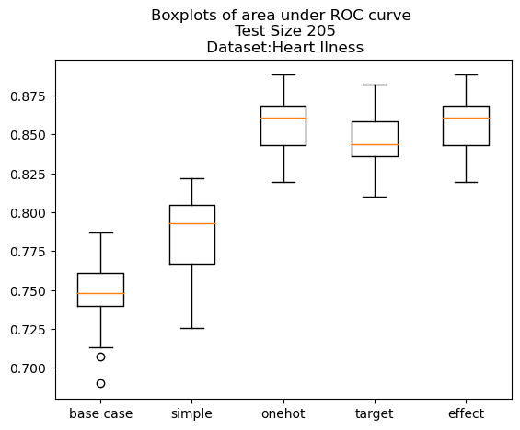
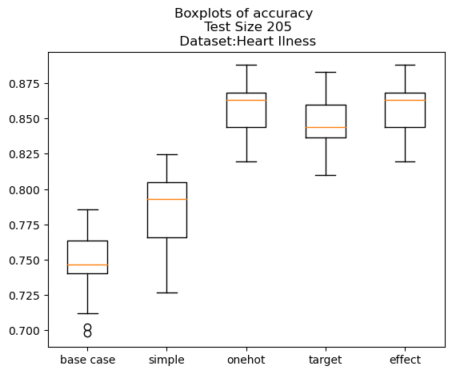
Heart Dataset – Logistic Classifier
- Base case: all categorical columns are removed

Slide 3
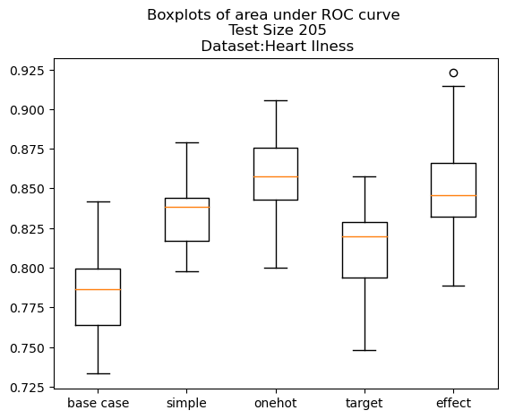
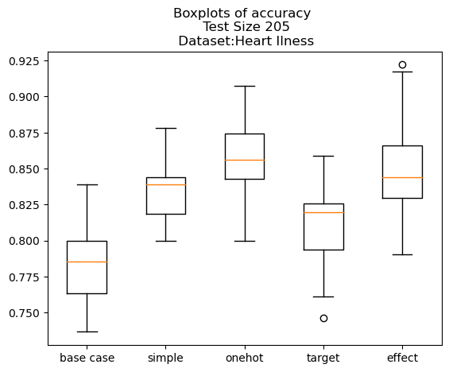
Heart Dataset – kNN Classifier
- Base case: all categorical columns are removed

Slide 4
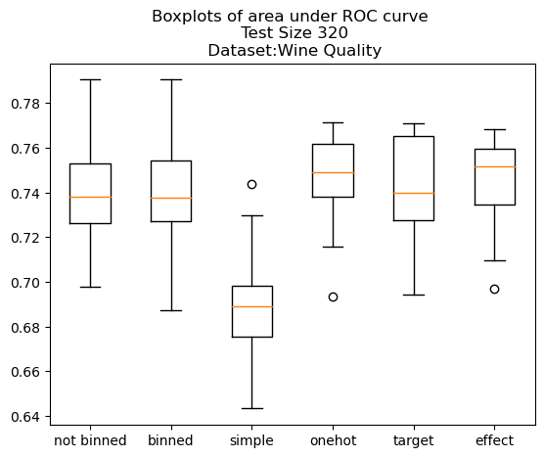
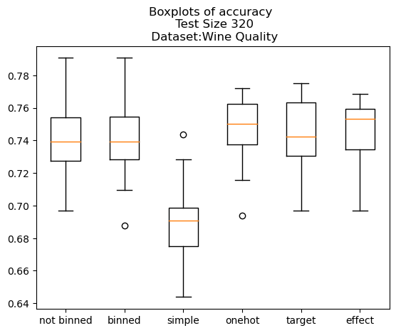
Wine Quality Dataset – Logistic Classifier
Not binned: no columns are binned
Binned: all columns are binned
Others: all columns are binned + encoded

Slide 5
Car Insurance Claim Dataset
A few issues and what I did regarding them:
Two of the variables max_torque and max_power were given in a strange format e.g., 60Nm @ 3500 rpm, 40.36bhp @ 6000rpm. Consequently, I tried:
Creating for each, 2 columns one corresponding to the Nm / bhp and the other one corresponding to RPM.
I thought (how much I understood the notions) that 60Nm @ 3500 RPM can be replaced by 60 x 3500 and similarly for the max_power, since these are measurable quantities that allow me to compare the instances.
The results were giving me all predicted 0s and no 1s and I realized the reason for that was the fact that the data was not balanced at all. I tried:
Just considering an equal amount of 1s and 0s from the beginning.
Reading all of the dataset but making sure in each fold we have both 0s and 1s.

Slide 6
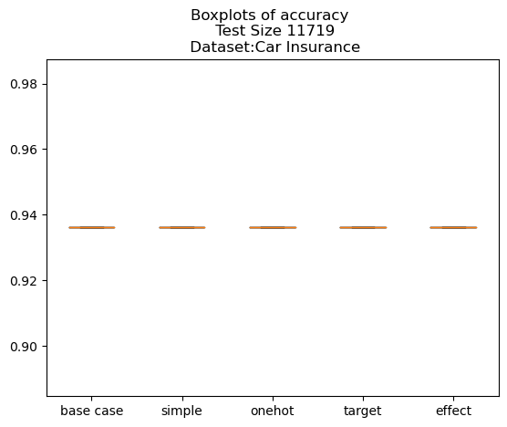
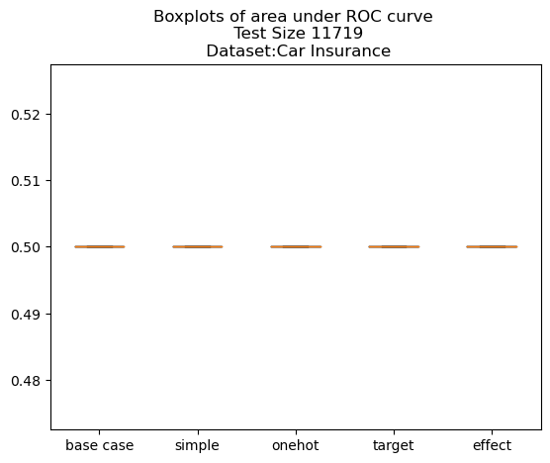
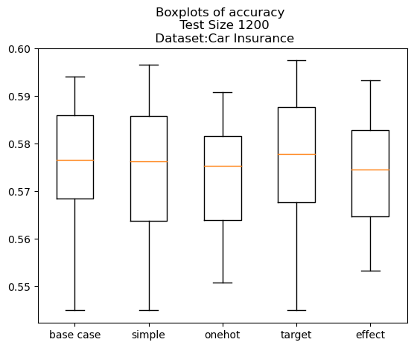
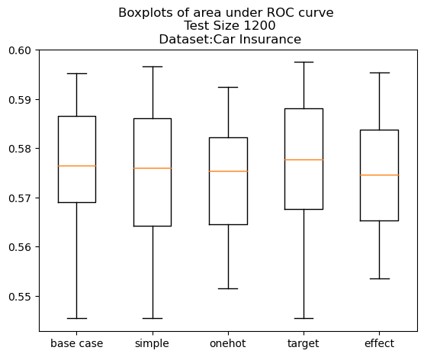
In the CV make sure there are both 0s and 1s, take 4/5 of the ones and 4/5 of the zeros
Two columns for max_torque and two columns for max_power
I used in my dataset an equal amount of 0s as 1s
Two columns for max_torque and two columns for max_power
Very similar results when considering product of the two numbers

Slide 7
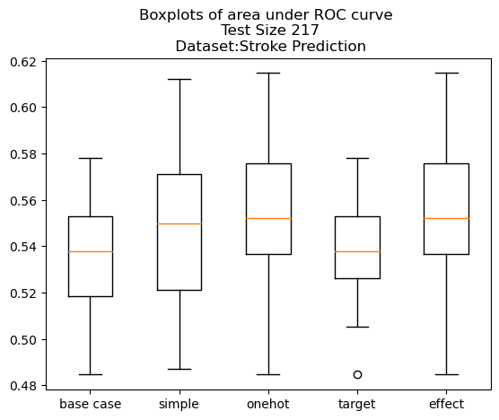
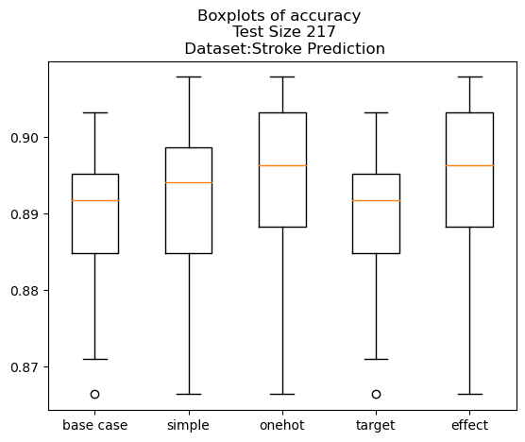
Stroke Prediction Dataset – Logistic Classifier
Base Case: no categorical

Slide 8
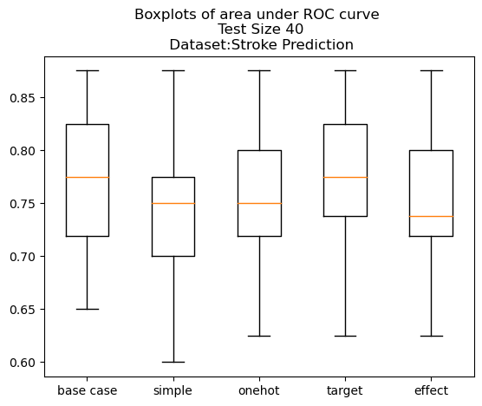
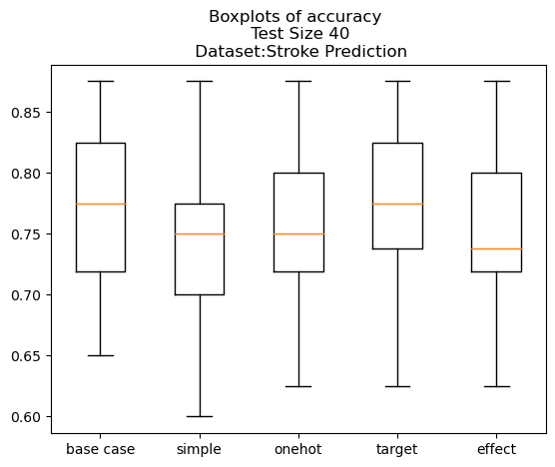
Stroke Prediction Dataset – Logistic Classifier
Base Case: no categorical
Since the plot before was obtained starting with unbalanced data, here I decided to consider equal number of 0s and 1s

Slide 9
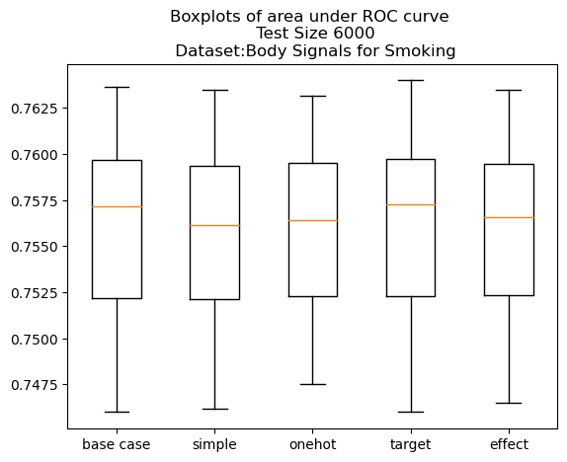
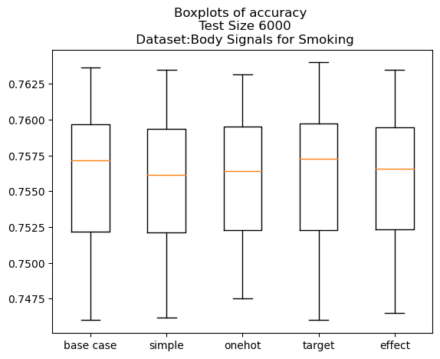
Body Signal Smoking Dataset – Logistic Classifier
Base Case: no categorical
The only categorical one is the Urine protein, but clearly it barely has any effect, so I thought instead to view everything as continuous and dealing with binning instead

Slide 10
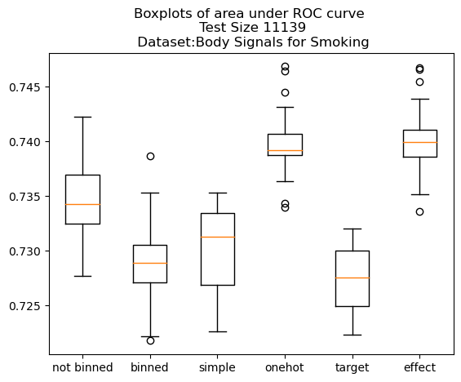
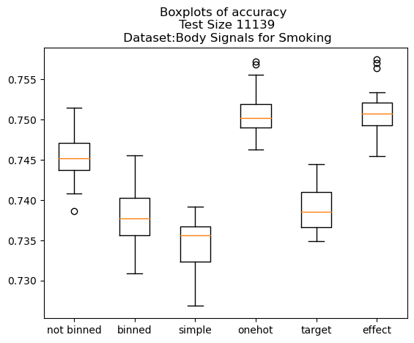
Body Signal Smoking Dataset – Logistic Classifier
Not binned: no columns are binned
Binned: all columns are binned
Others: all columns are binned + encoded

Slide 11
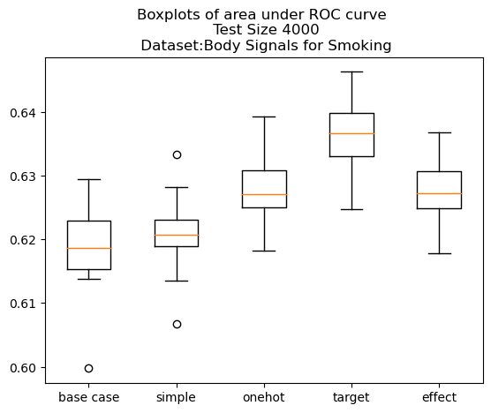
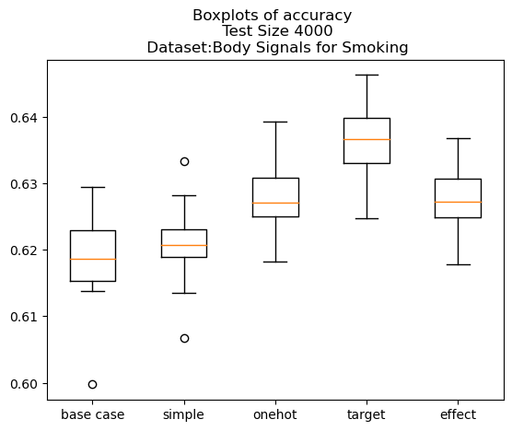
Airline Delay Predicition – Logistic Classifier
Base Case: no categorical
The only categorical one is the Urine protein, but clearly it barely has any effect, so I thought instead to view everything as continuous and dealing with binning instead

Slide 12
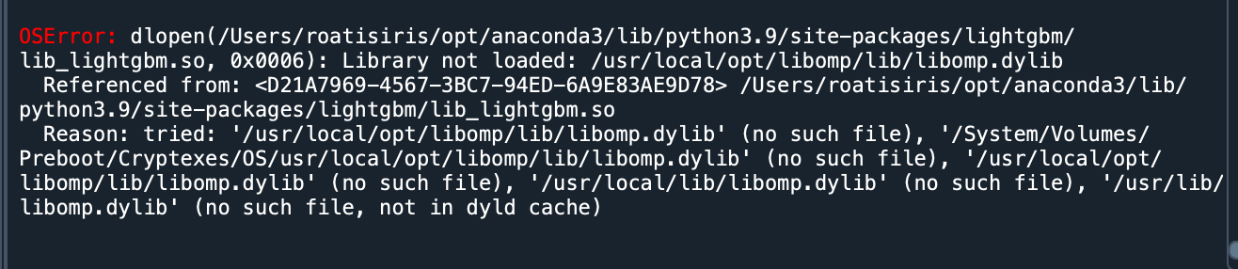
PyCaret
Big problems with making it work on my laptop, no idea why it does not work
I managed to play around with it a bit on my other computer

Slide 13
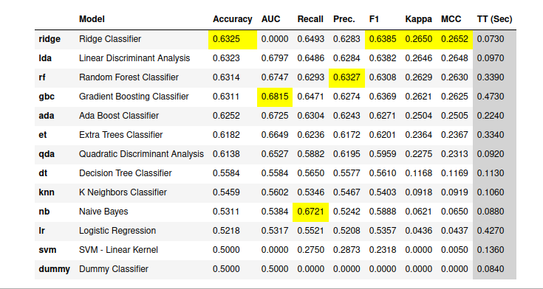
Airline Dataset
- I selected 4000 0s and 4000 1s

Slide 14
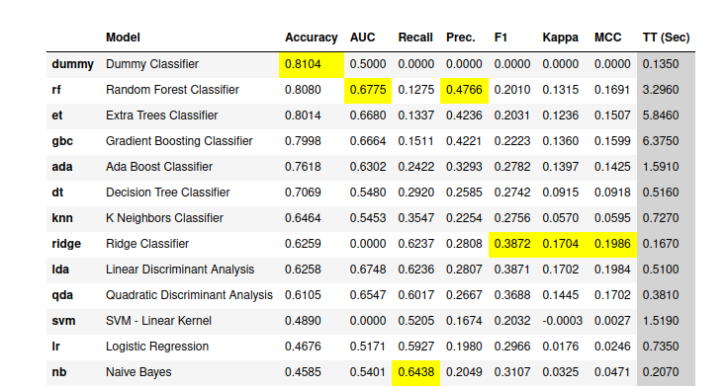
Airline Dataset
- I read the first 50000 lines and used fixed_imbalance

